Slide 1
Alarm clock

Slide 2
What have I created?
A tool with multiple functionalities
A timer
An alarm clock
A Stopwatch

Slide 3

Timer
Timer counts down given by user time. After timer reaches value 0 it make a noise

Slide 4
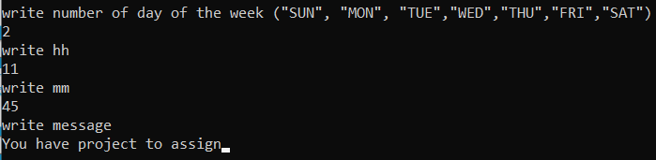
Alarm clock
Alarm clock makes a noise when given time is equal to system time.
You can also specify the day of the week

Slide 5
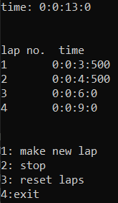
Stopwatch
Stopwatch measures time. It has functionality to:
- remember time after pressing ‘1’
- make a pause
- stop measurement
- exit

Slide 6

Problems during project creation
There was an attempt to make a function which would open a new console
There were experiments with ctime library

Slide 7
What have I learned
I got acquinted with ctime library
Playing sound from file.wav
Function kbhit()
Being more confident with object programming

Slide 8

What could be improved?
The functionality to make your own songs as alarm sound, there could be different alarms for timer and for alarm clock
Stopwatch could show time difference between laps

Slide 9
Thank you for your attention
Igor Świątek

